Slide 1
Part 2 Chapter 6
Roots: Open Methods

Slide 2
Chapter Objectives
Recognizing the difference between bracketing and open methods for root location.
Knowing how to solve a roots problem with the Newton-Raphson method
Knowing how to implement both the secant method.
Knowing how to use MATLAB’s fzero, roots, and poly functions.

Slide 3
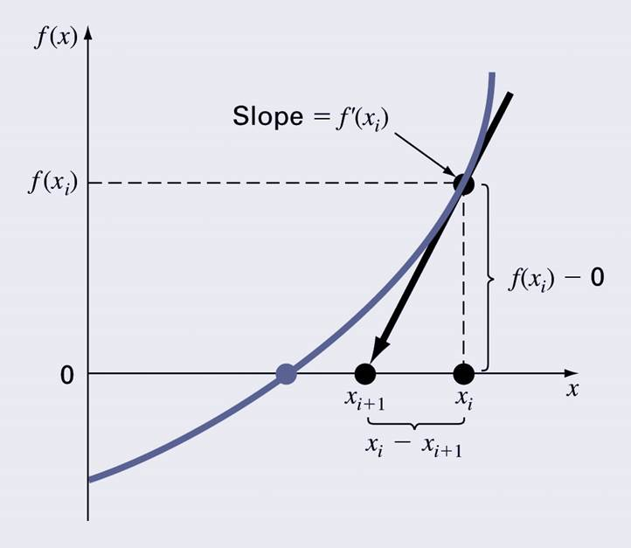

Newton-Raphson Method – An open method
Open methods differ from bracketing methods, in that open methods require only a single starting value
Open methods may diverge as the computation progresses, but when they do converge, they usually do so much faster than bracketing methods.
Newton Raphson method
$$f^{′}\left(xi\right)=\frac{f\left(xi\right)−0}{x_{i}−x_{i+1}}$$
$$xi\text{+}1=xi−\frac{f(xi)}{f′(xi)}$$

Slide 4
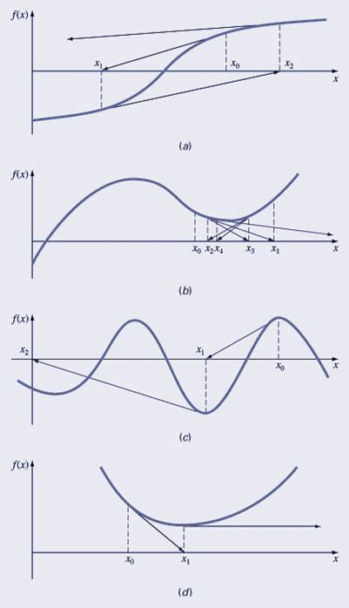
Pros and Cons
Pro: The error of the i+1th iteration is roughly proportional to the square of the error of the i^{th} iteration - this is called quadratic convergence
Con: Some functions show slow or poor convergence or divergence!

Slide 5
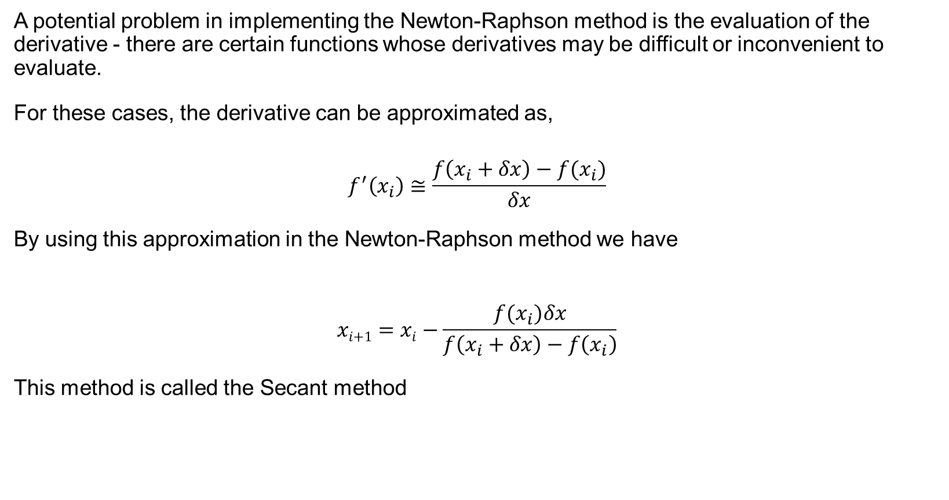
Secant Method
A potential problem in implementing the Newton-Raphson method is the evaluation of the derivative - there are certain functions whose derivatives may be difficult or inconvenient to evaluate.
For these cases, the derivative can be approximated as,
$$f^{′}\left(x_{i}\right)≅\frac{f\left(x_{i}+δx\right)−f(x_{i})}{δx}$$
By using this approximation in the Newton-Raphson method we have
$$xi\text{+}1=xi−\frac{f(x_{i})δx}{f\left(x_{i}+δx\right)−f\left(x_{i}\right)}$$
This method is called the Secant method

Slide 6
MATLAB’s fzero Function
MATLAB’s fzero provides the best qualities of both bracketing methods and open methods.
Using an initial guess: x = fzero(function, x0) [x, fx] = fzero(function, x0)
function is a function handle to the function being evaluated
x0 is the initial guess
x is the location of the root
fx is the function evaluated at that root
Using an initial bracket: x = fzero(function, [x0 x1]) [x, fx] = fzero(function, [x0 x1])
As above, except x0 and x1 are guesses that must bracket a sign change

Slide 7
Polynomials, 1
MATLAB has a built in program called roots to determine all the roots of a polynomial - including imaginary and complex ones.
x = roots(c)
x is a column vector containing the roots
c is a row vector containing the polynomial coefficients
Example:
Find the roots of f(x) = x⁵ − 3.5x⁴ + 2.75x³ + 2.125x² − 3.875x + 1.25
x = roots([1 -3.5 2.75 2.125 -3.875 1.25])

Slide 8
Polynomials, 2
MATLAB’s poly function can be used to determine polynomial coefficients if roots are given:
b = poly([0.5 -1])
Finds f(x) where f(x) =0 for x=0.5 and x=-1
MATLAB reports b = [1.000 0.5000 -0.5000]
This corresponds to f(x)=x²+0.5x-0.5
MATLAB’s polyval function can evaluate a polynomial at one or more points:
>> a = [1 -3.5 2.75 2.125 -3.875 1.25];
If used as coefficients of a polynomial, this corresponds to f(x)=x⁵-3.5x⁴+2.75x³+2.125x²-3.875x+1.25
polyval(a, 1)
This calculates f(1), which MATLAB reports as -0.2500

Slide 9

Poly and roots commands
Use the Poly and roots commands to determine the roots of
$$f\left(x\right)=x^{5}−16.05 x^{4}+88.75x^{3}−192.0375x^{2}+116.35x+31.6875$$

